Slide 1
TERRAIN MODEL GENERATION FROM POINT CLOUD CS513-FINAL PROJECT
SUBMITTED BY:
ROY, Subhadeep,
TIMMERMAN, Thibault,
GARG, Nishtha,
KAUR, Joeldeep

Slide 2
CODING ENVIRONMENT
Python 2.7
COLORSYS: For bi-directional conversions between HSV and RGB color systems.
BOKEH: For visualization of point cloud data.
NUMPY: To convert images in matrix and make operations on them.
PCL: Used for Point Cloud processing.
MATLAB
POINT CLOUD CLASS: Used to read/manipulate/write point cloud points.

Slide 3
FIRST APPROACH - PYTHON

Slide 4
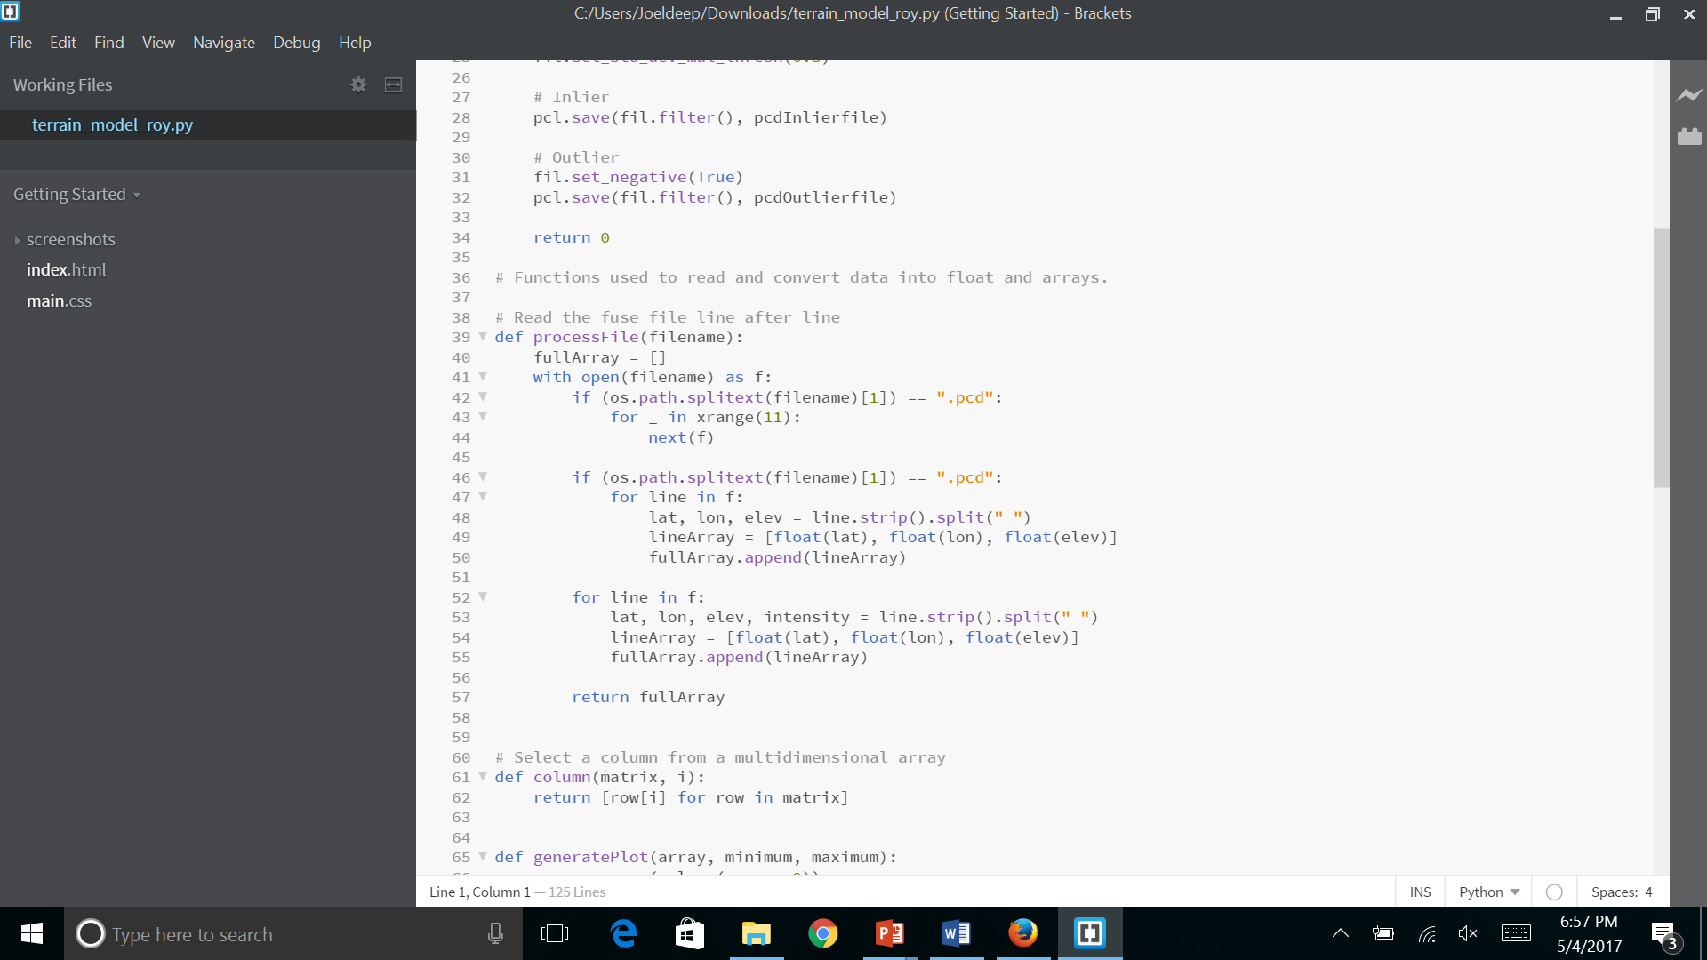
Read data file
The data is read line by line and is converted into float.
The resulting data is stored in an array.

Slide 5
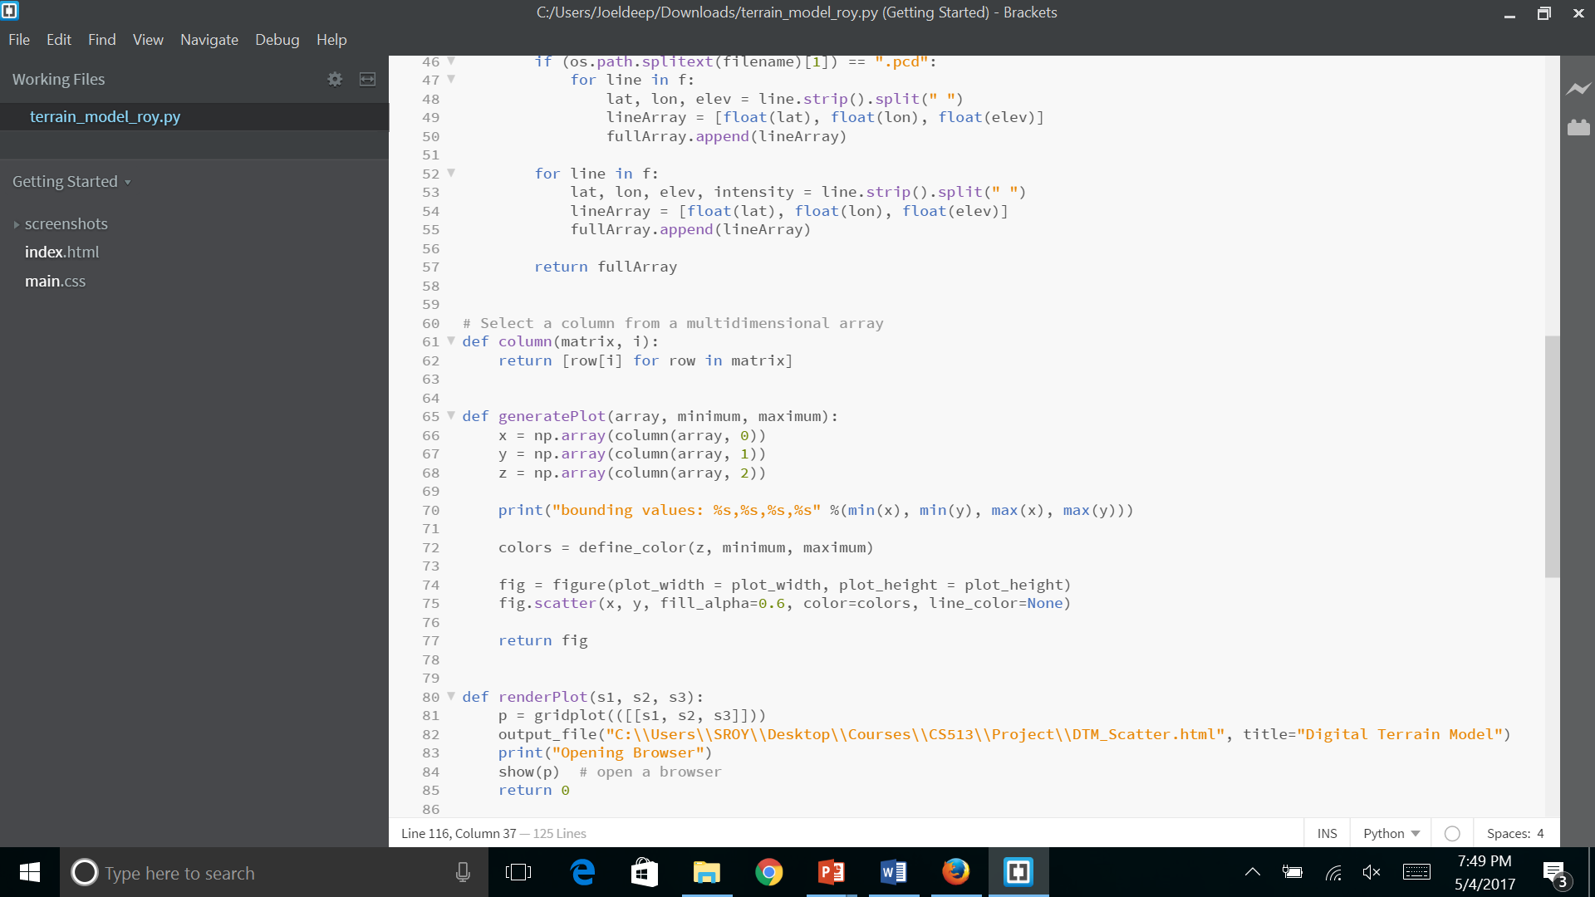
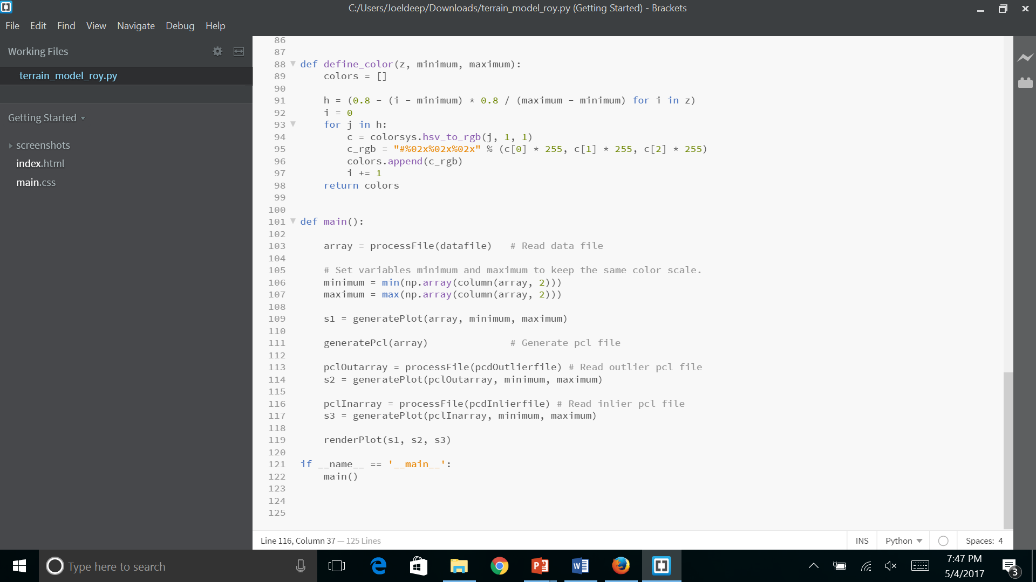
Setting PLOT for the Original DATA
Find the min and max value of the Altitude to set the color range accordingly.
Create an object using the scatter plot from original array along with the min and max values calculated above

Slide 6
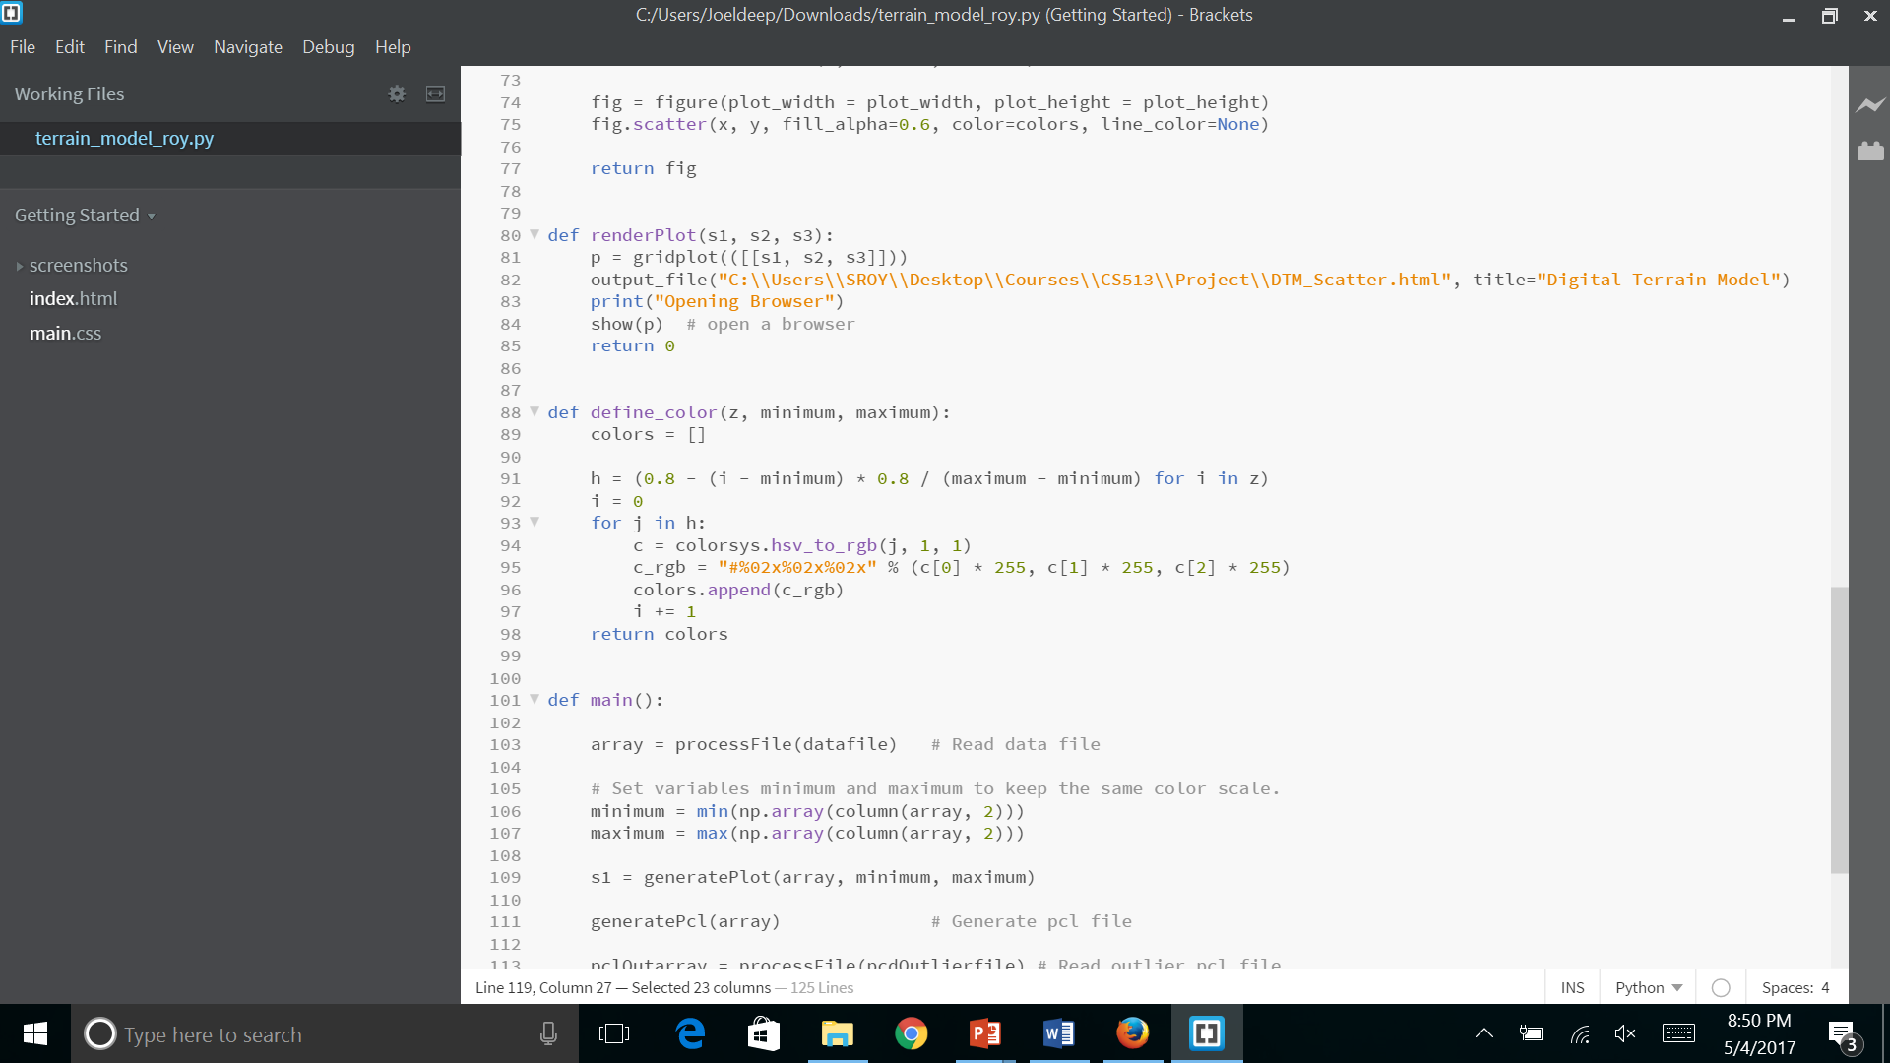
Define color
Using HSV color system
Convert the altitude into color:
Range of altitude become a range within 0 and 0.8 to set the color
Red means highest altitude
Bleu means lowest altitude

Slide 7
Light pole

Slide 8
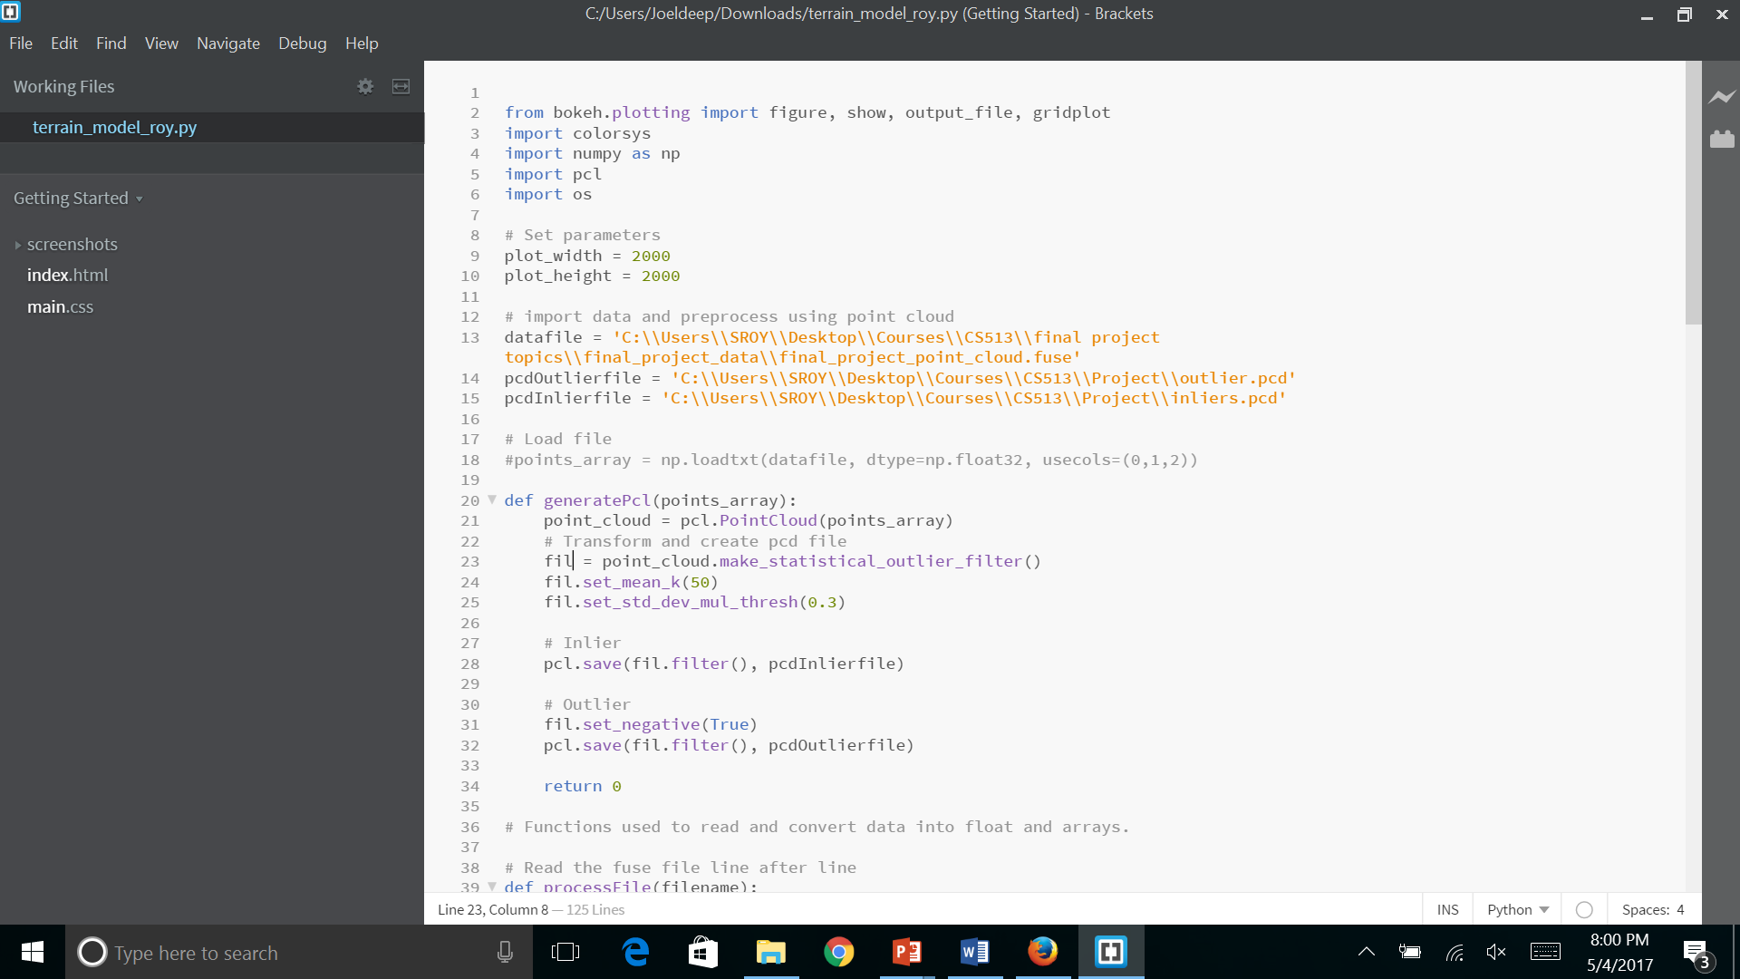
FILTERING THE OBJECTS
Load the PCL file and convert it into PCD format.
Data is first filtered using make_statistical_outlier_filter() on the basis of variance and stored in pcd object (fil).
Further K-means is applied and followed by setting standard deviation threshold to 0.3.

Slide 9
GENERATING Inliers and outliers
Creating Outliers:
The outliers are generated by taking an inverse of the filtered data i.e. the unfiltered data values are set true.

Slide 10
GENERATING Inliers and outliers
Creating Inliers:
The inliers are the actual data which we got by the process of filtering the objects above.

Slide 11

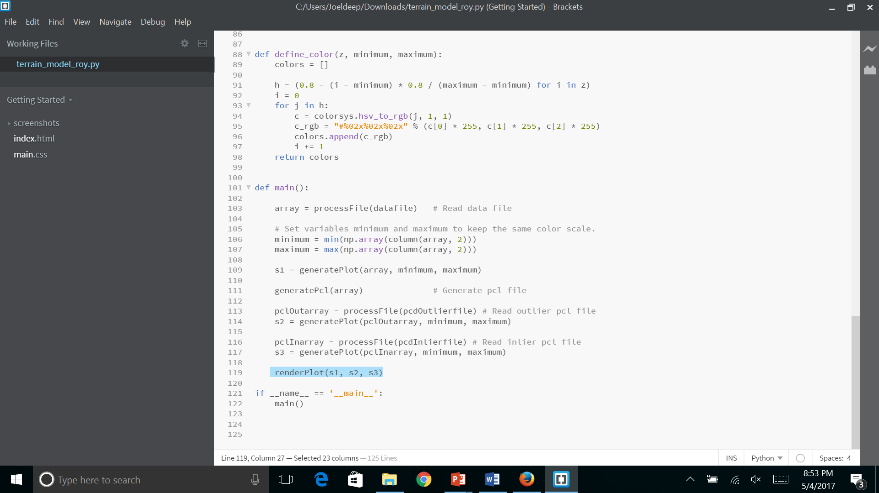
Processing the inliers and outliers
The Inliers and Outliers are processed as follows:
The inlier/outlier data is first read using processFile(datafile) function
The plot properties for Inlier PCD and Outlier PCD are set by using generatePlot(datafile, minimum, maximum).
Plotting the result:

Slide 12
PLOTTING THE ORIGINAL DATA, OUTLIERS AND INLIERS
Original point cloud
Outliers
Final result

Slide 13
SECOND APPROACH – USING MATLAB

Slide 14
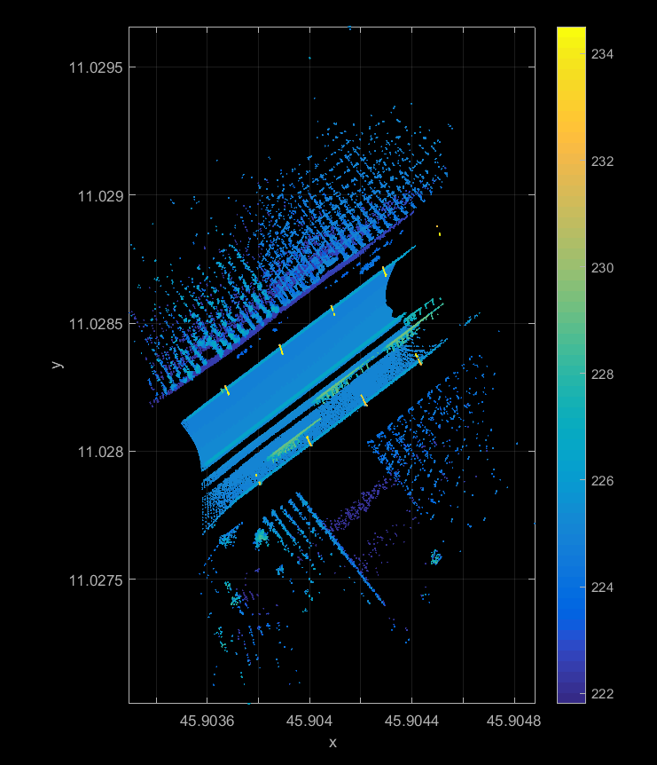
VISUALIZE THE DATA
Plot the point cloud data using the Point Cloud Class.

Slide 15
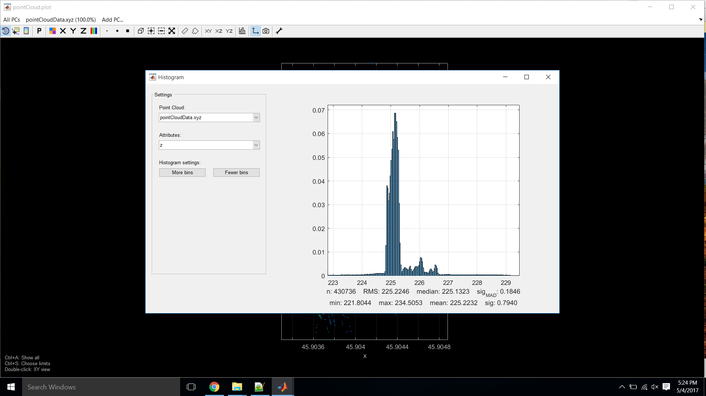
HISTOGRAM OF THE VISUALIZED DATA
This histogram gives us the distribution of the data points with respect to the altitude values. And the range for the occurrence of maximum number of data points can be seen.
Statistically, this range contains the mode value (the maximum frequency of occurrence of the data points).

Slide 16
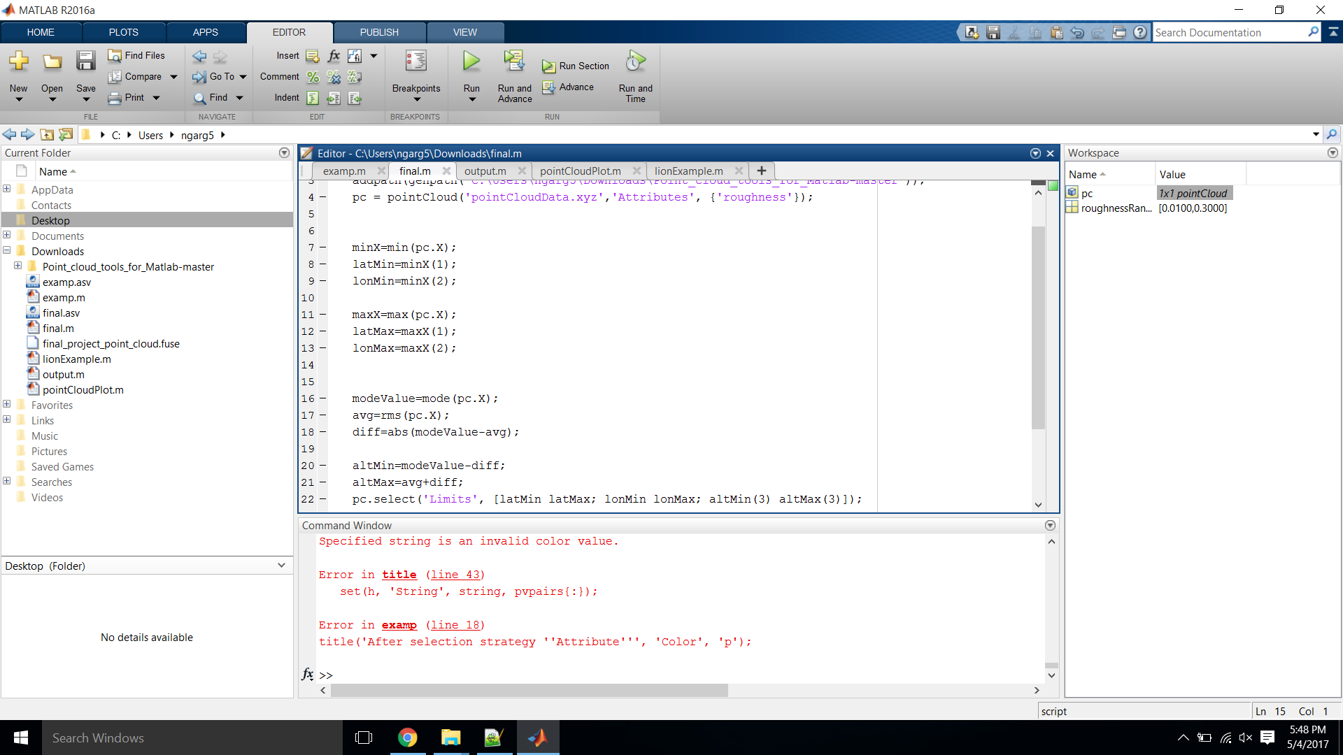
FINDING THE RANGE OF MAXIMUM OCCURRENCE OF POINT CLOUD DATA
Determine the mode value for the point cloud data.
Finding the root mean square value.
Calculate the absolute difference between the above two values.

Slide 17
APPLYING THE LIMIT FUNCTION
Makes the selection of the points based on the altitude range calculated previously.

Slide 18
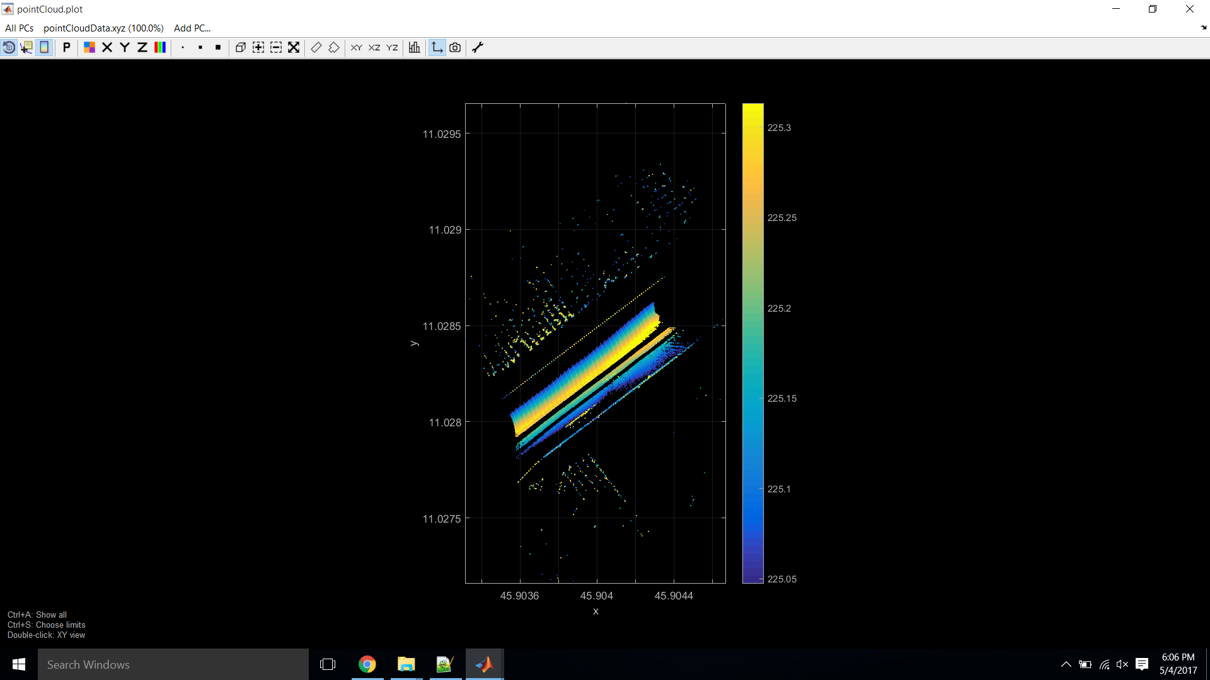
PLOT THE POINT CLOUD DATA
The data points that were lying outside the calculated range(desired range) have been removed.

Slide 19
Applications
Transportation system planning
Model water flow or other movements (for example, to run simulated avalanches or landslides),
Geological Applications

Slide 20
REFERENCES
http://www.geo.tuwien.ac.at/downloads/pg/pctools/pctools.html#PointCloud_class
https://en.wikipedia.org/wiki/Digital_elevation_model

Slide 21
THANK YOU !!!

